Slide 1
FutureWorks Solutions – An Employability Analytics Application.
Group - 13

Slide 2

Description
To help out an individual who is interested in learning more about various aspects of employability to help in process of making informed decisions about specific job roles where we are planning to use web scraping to collect the latest data from different platforms and apply various machine learning algorithms to do the analysis and prediction.

Slide 3
Applying machine learning algorithms to the data
Data Collection using web scraping
Creating a dashboard using tableau
1
2
3
4
5
Data segregation and cleaning
Predictive analysis

Slide 4
Focus Area
Development of an application to transform diverse employability data into actionable insights for informed career decisions.
Focus on solving challenges like career path selection, skill development, job application strategies, and education planning.
Empowerment of users with real-time, data-driven intelligence to enhance employability and navigate the evolving job market effectively.
Utilization of interactive tools like career path maps, skill gap analysis, and personalized dashboards for a user-friendly experience.

Slide 5
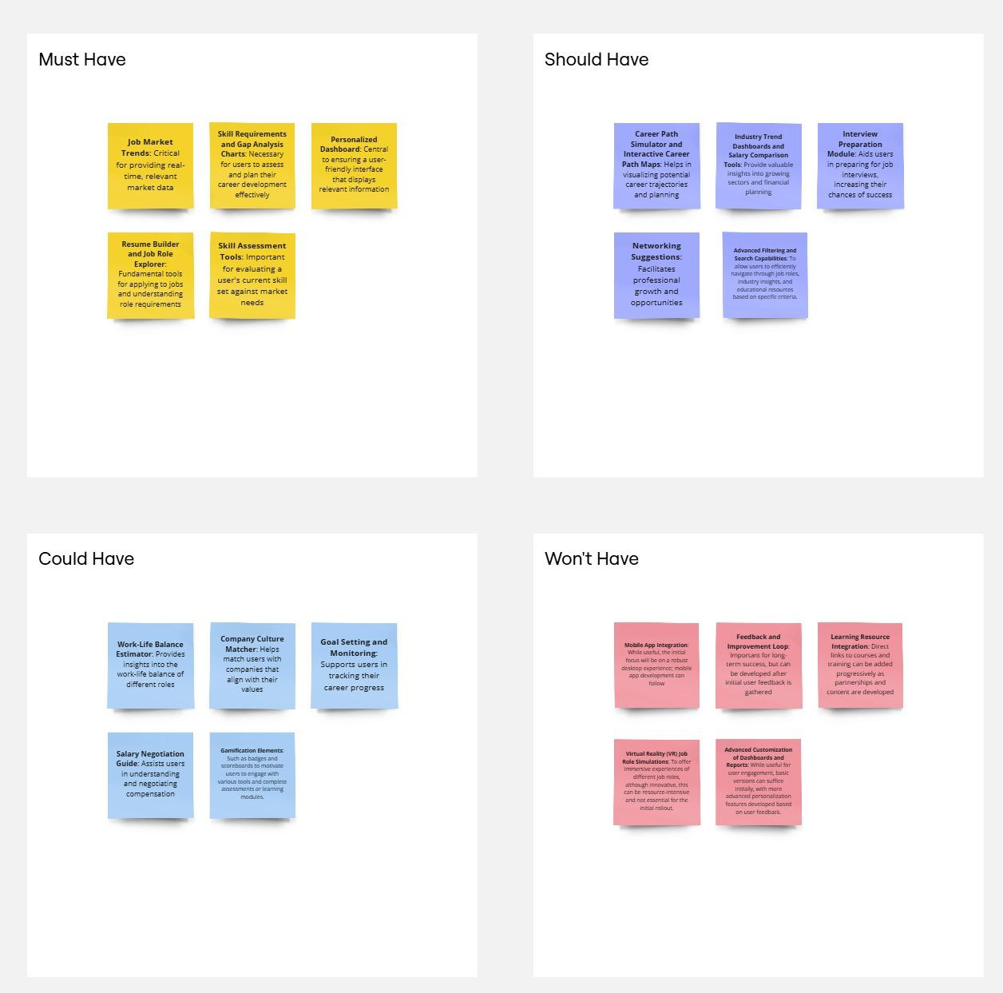
MoSCoW Matrix

